Slide 1
Fernando Masanori
linktr.ee/fmasanori
bit.ly/PPZPythonExercicios

Slide 2

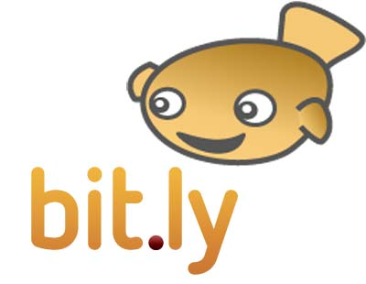


Python: quem usa
1h video/s 4 billion views.

Slide 3




Python: quem usa

Slide 4

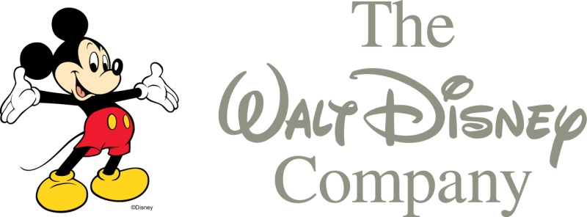



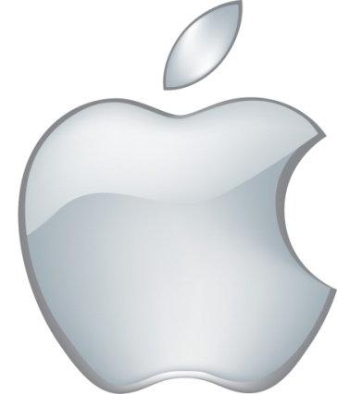

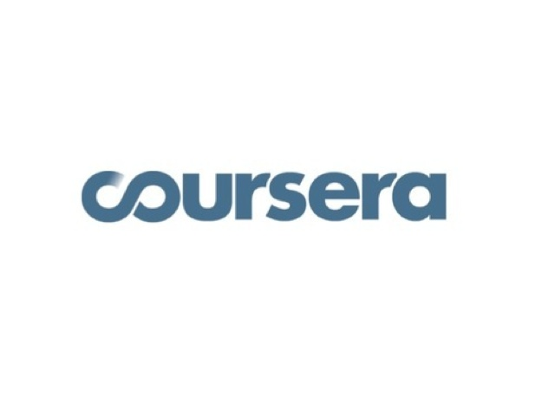




Python: quem usa

Slide 5
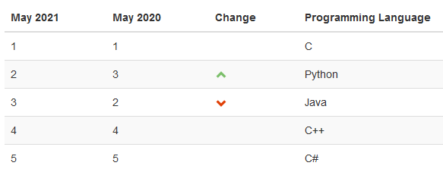
Segundo Lugar Tiobe Index

Slide 6
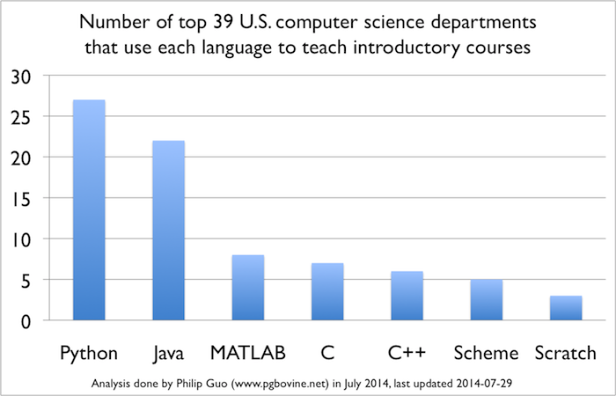
Why Python?
http://cacm.acm.org/blogs/blog-cacm/176450-python-is-now-the-most-popular-introductory-teaching-language-at-top-us-universities/fulltext

Slide 7
Why Python?
"Results show that many aspects of traditional C-style syntax, while it has influenced a generation of programmers, exhibits problems in terms of usability for novices".
"Perl and Java did not accuracy rates significantly higher than a language with randomly generated keywords"
Andreas Stefik and Susanna Siebert: "An Empirical Investigation into Programming Language Syntax." ACM Transactions on Computing Education, 13(4), Nov. 2013.

Slide 8
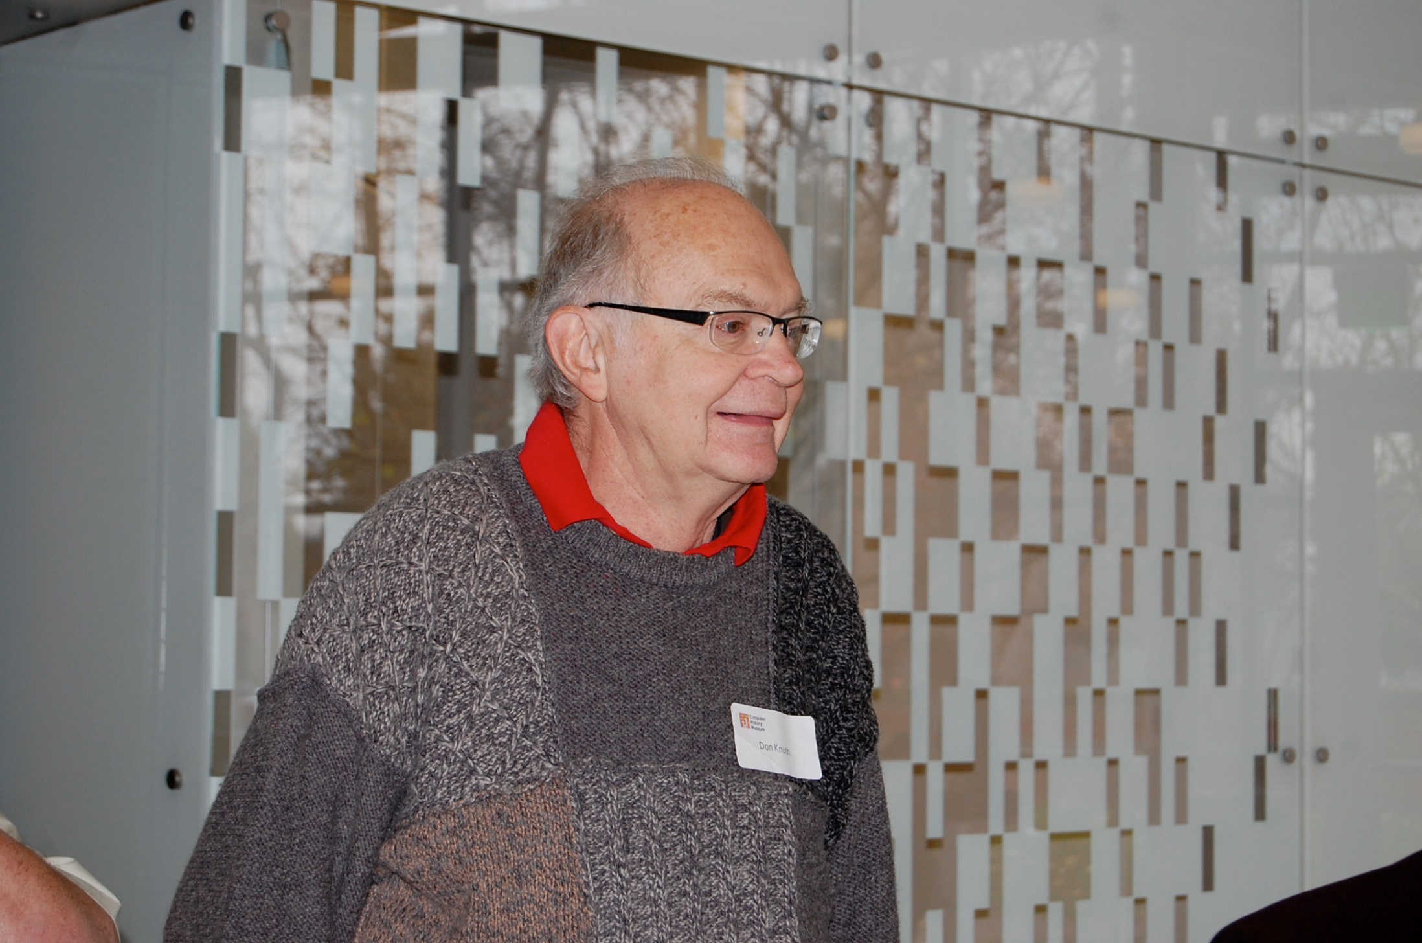
The most common fault in computer classes is to emphasize the rules of specific programming languages, instead of to emphasize the algorithms that are being expressed in those languages. D. Knuth interview at People of ACM, June, 2014.

Slide 9
“We want our community to be more diverse: whoever you are, and whatever our background, we welcome you”
http://www.python.org/psf/diversity/
Notes:
Aluno de minicurso que trabalha com oceanografia e mexe com software para surfistas. Cícero Moraes: Reconstituição forense digital, Santo Antônio e Maria Madalena. Python e Religião. Vou dar um curso em julho para jornalistas. Diversidade é importante para gerar novos negócios. E também para nos enriquecermos como pessoas. O simples fato de escutar pessoas que são diferentes nos enriquece como pessoas, aumenta nossa capacidade de empatia.

Slide 10
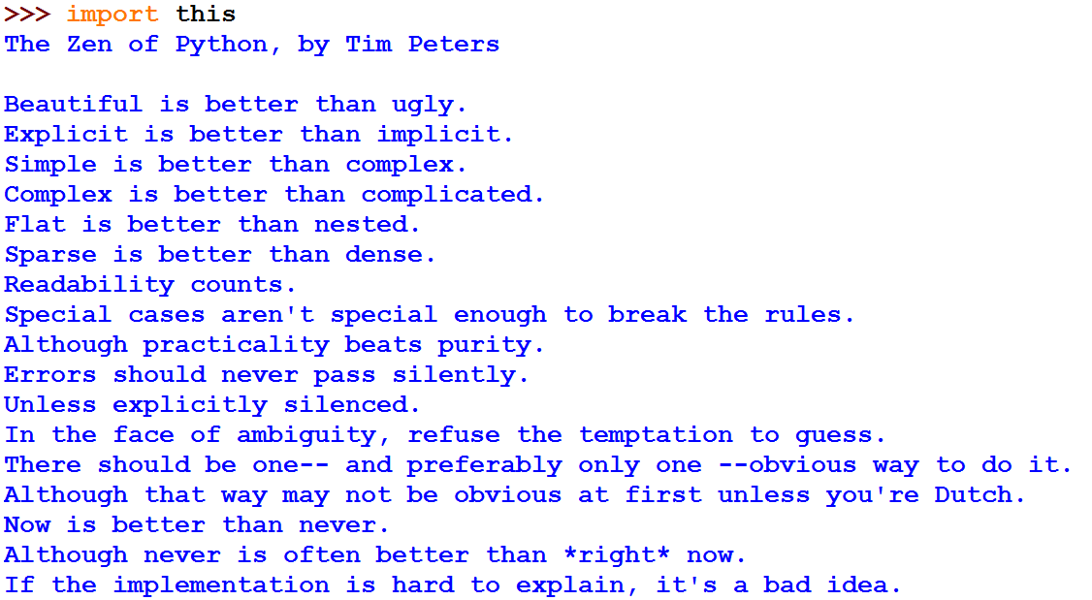
Build a community == Unity in diversity
Notes:
Tarcísio Tanaka, arito, python == clear

Slide 11

Unity + Diversity = community
Notes:
Zen do Python dá um jeito de pensar comum. Além disso temos o Guido que é o Ditador Benevolente. Temos uma direção, podemos gostar ou não, mas temos uma direção que dá uma unidade nos esforços da comunidade.

Slide 12
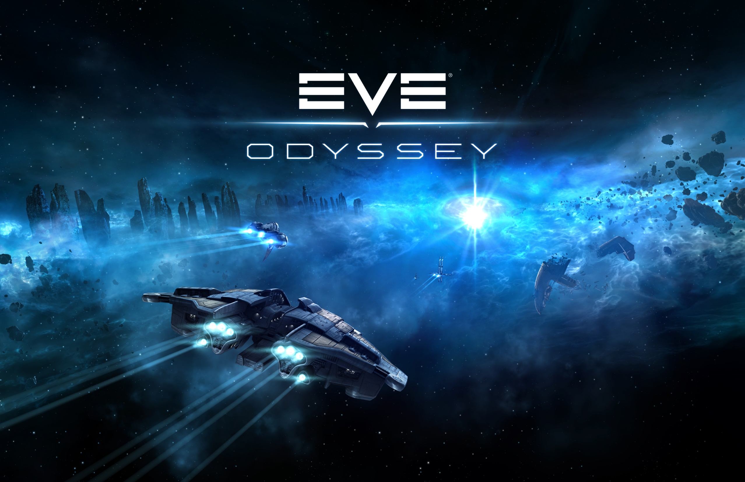

Slide 13


Slide 14
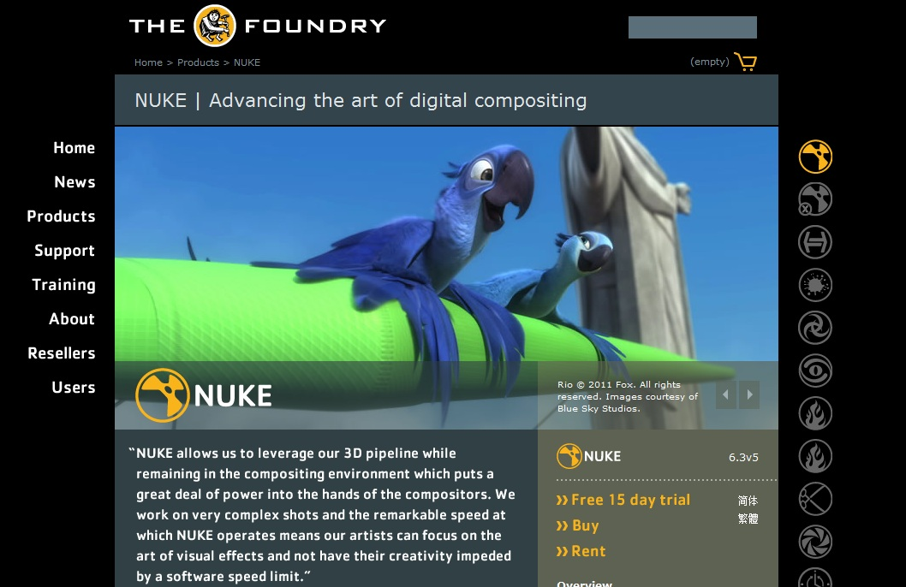
Python: quem usa

Slide 15
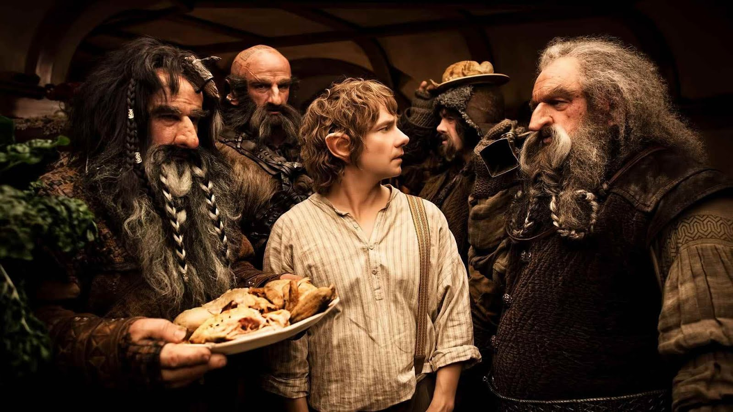

Python: quem usa

Slide 16
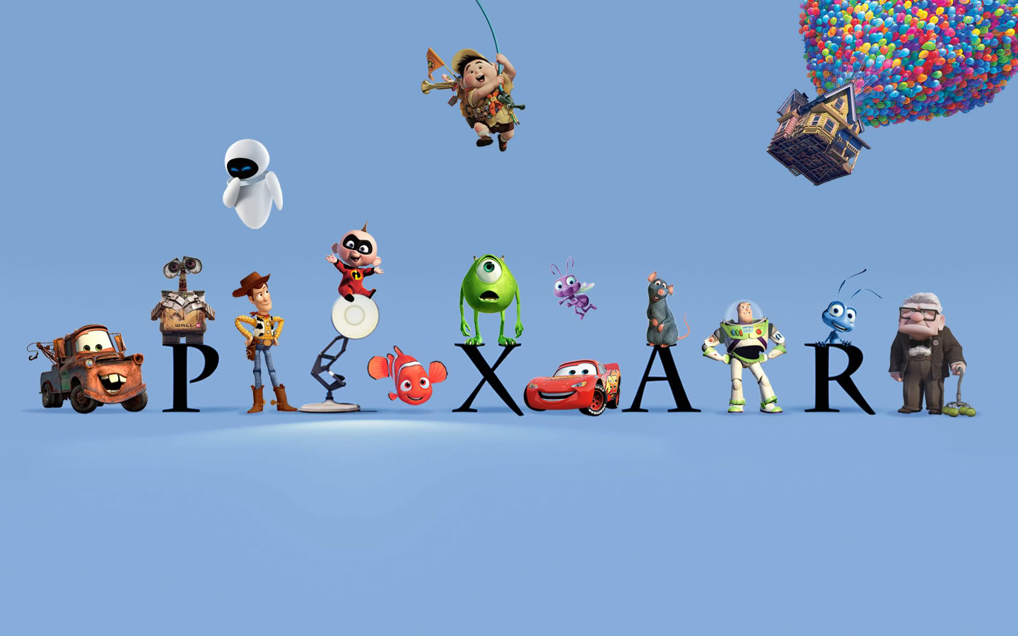
Python: quem usa

Slide 17
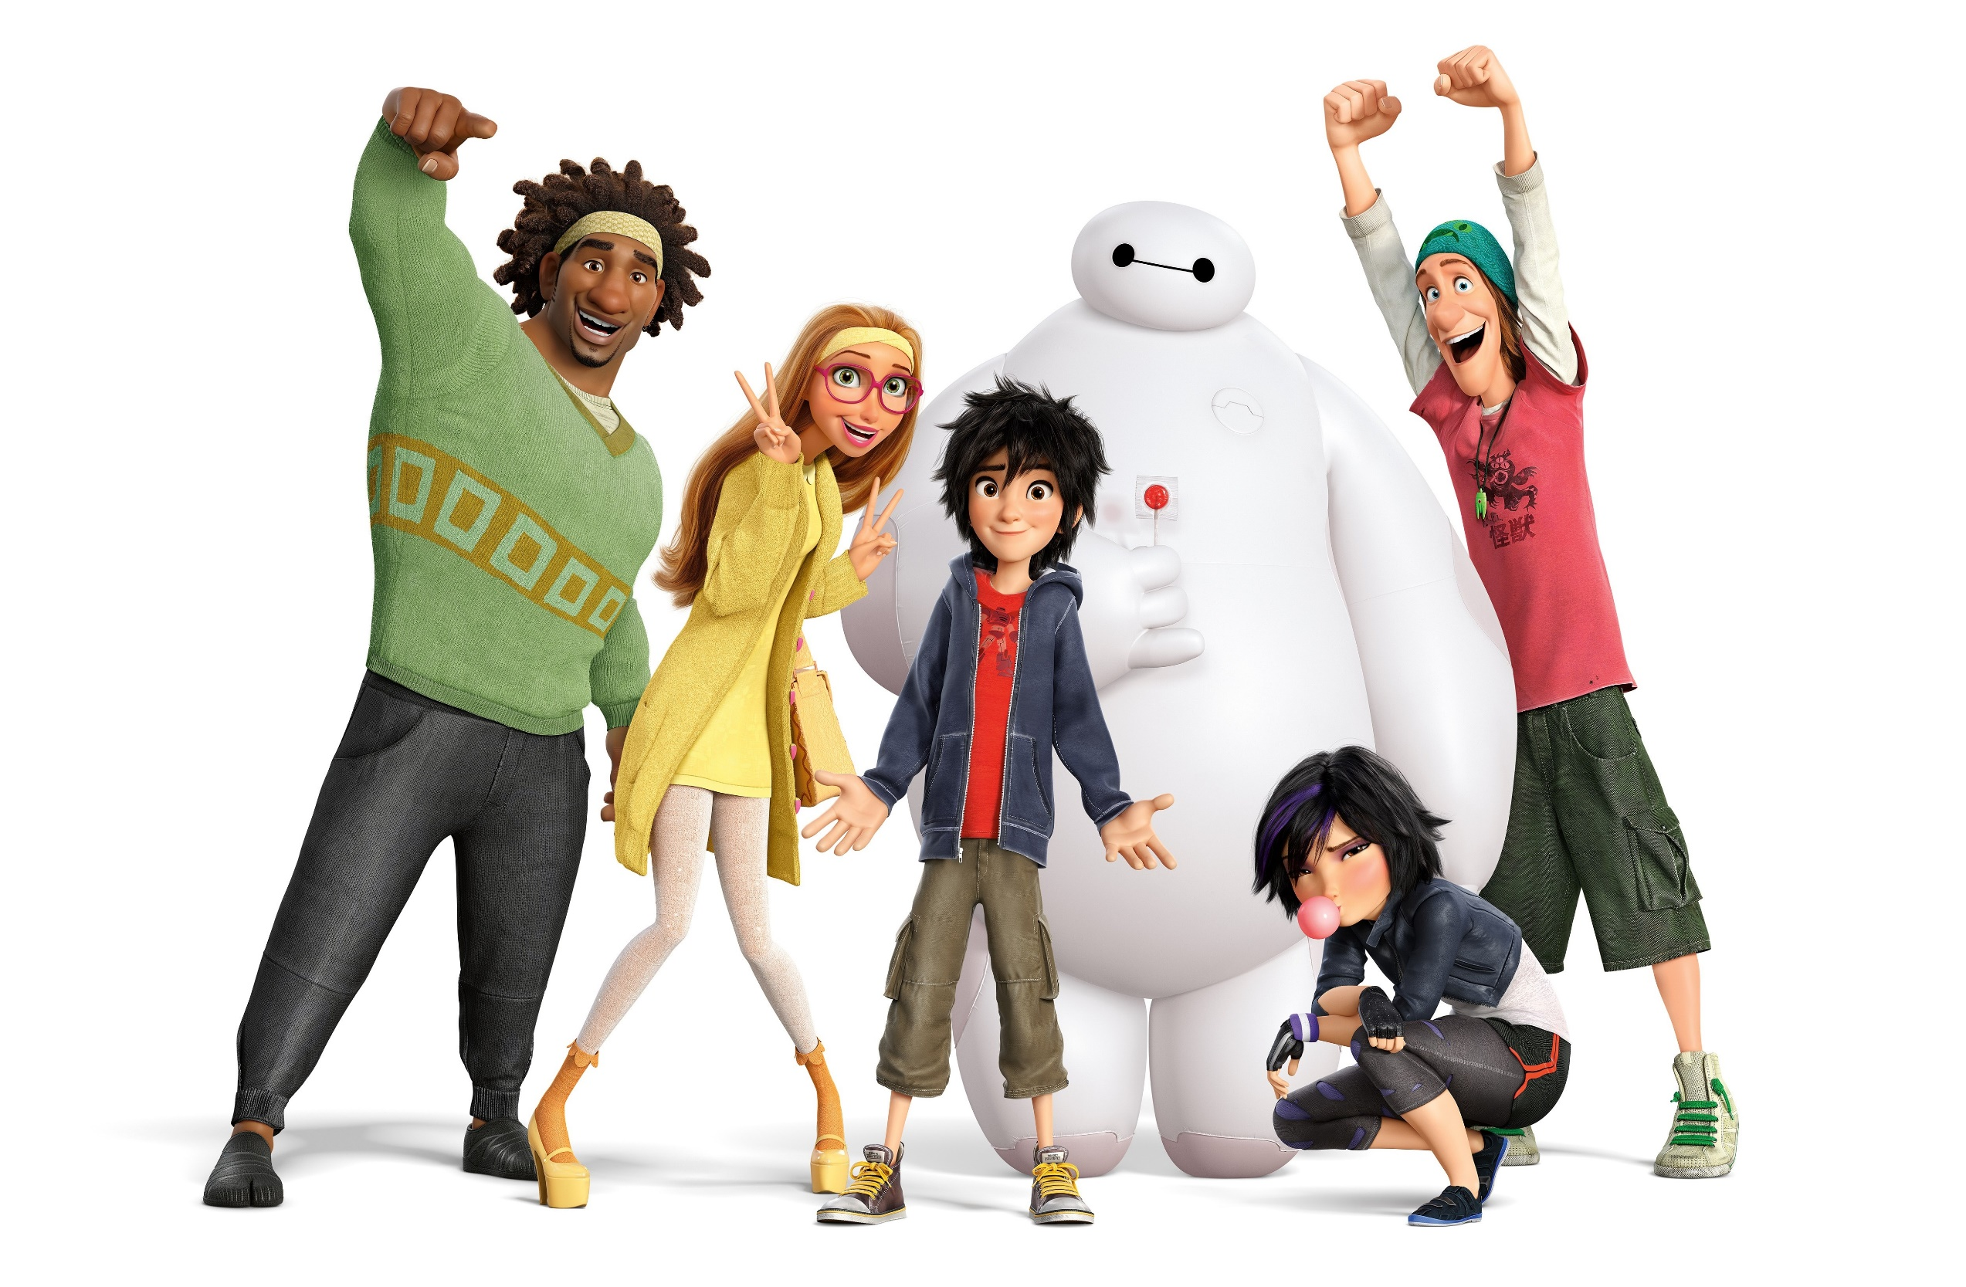

Slide 18
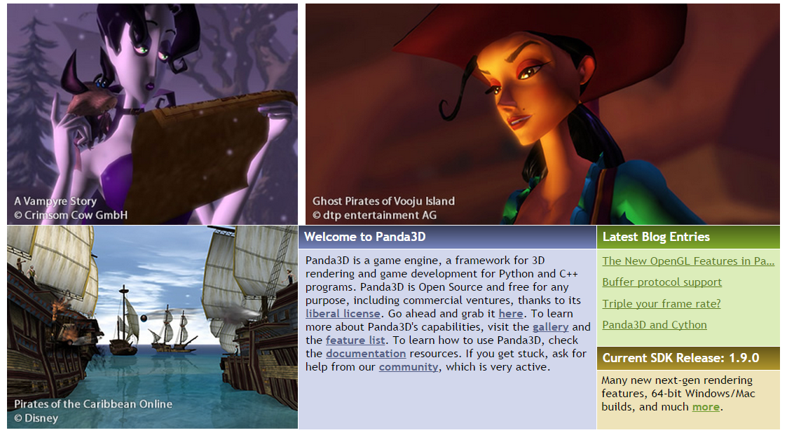
Carnegie Mellon: Pandas3D

Slide 19
Vale a pena?
Back-end
Linguagem de “grude”
Linguagem Hacker
Padrão para CG
Fácil de aprender (baterias inclusas)

Slide 20
Vale a pena?
Blender: opção livre 3DMax, Maya
Animação e Modelagem 3D
Game Engine e Plugins
Cenas, Entidades, Física
Sensores, controladores, atuadores

Slide 21
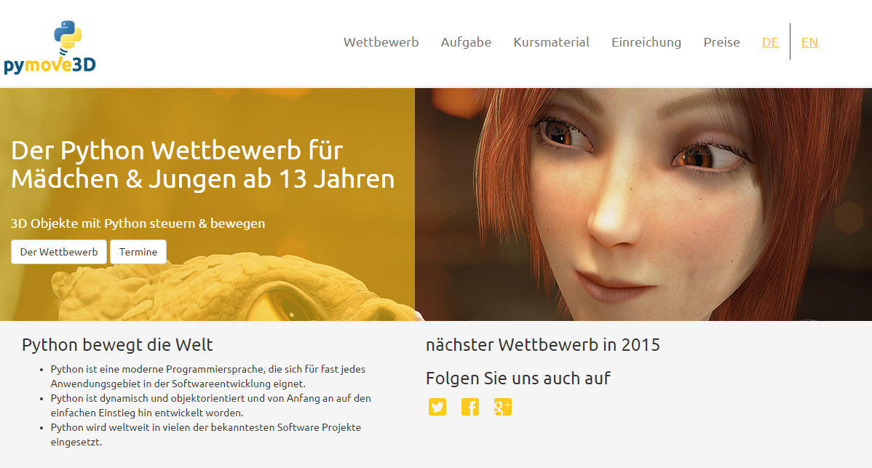
pymove3D

Slide 22
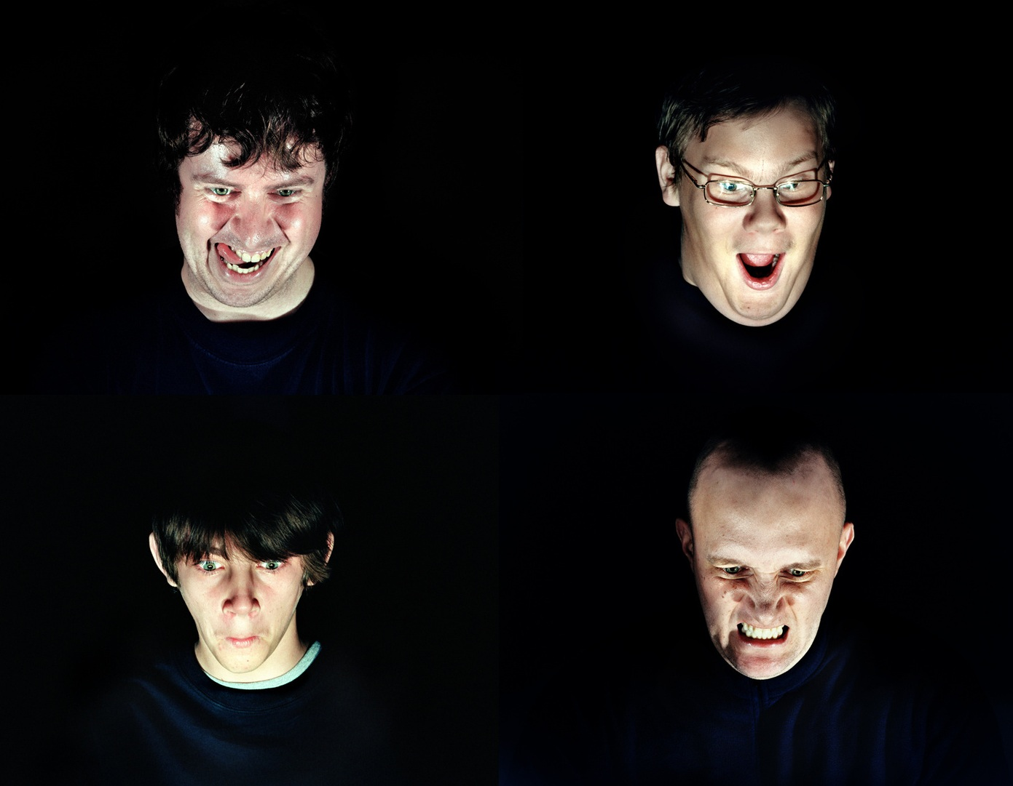

Classic Games with Python
in the browser

Slide 23


Epic win

Slide 24
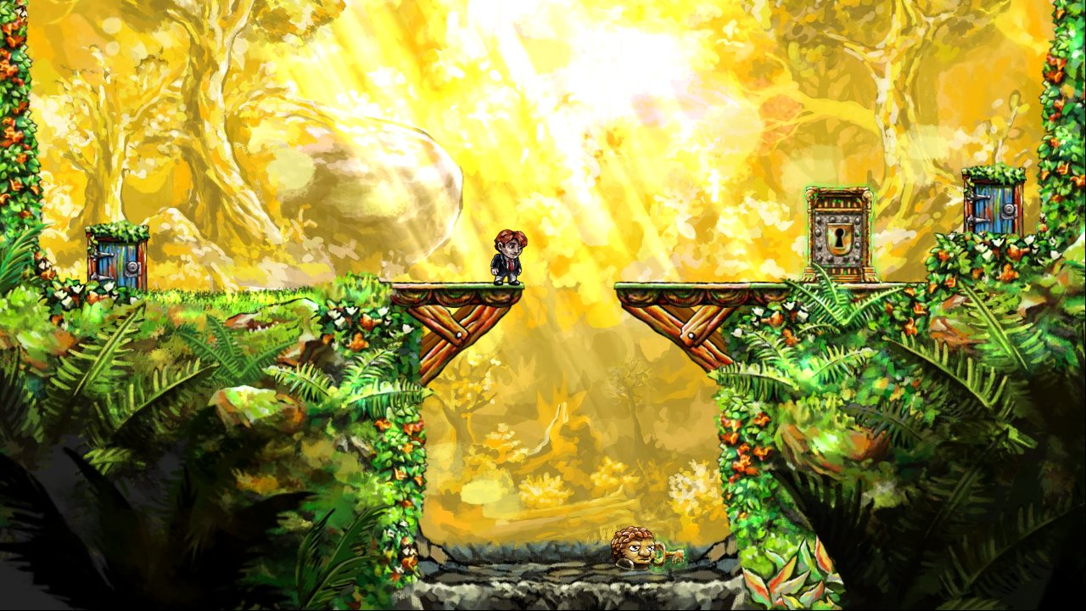
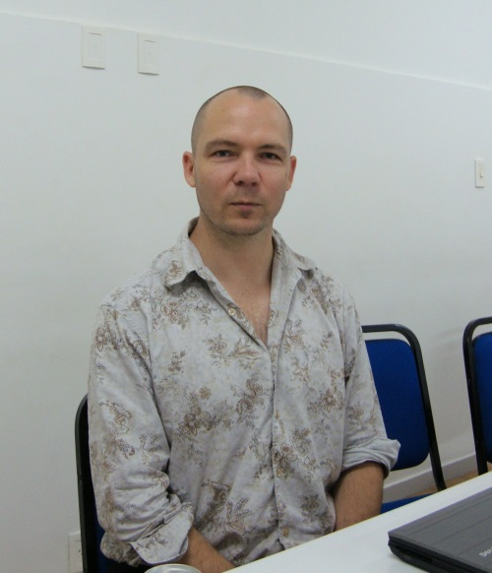
Indie games is a goal for many dev’s

Slide 25
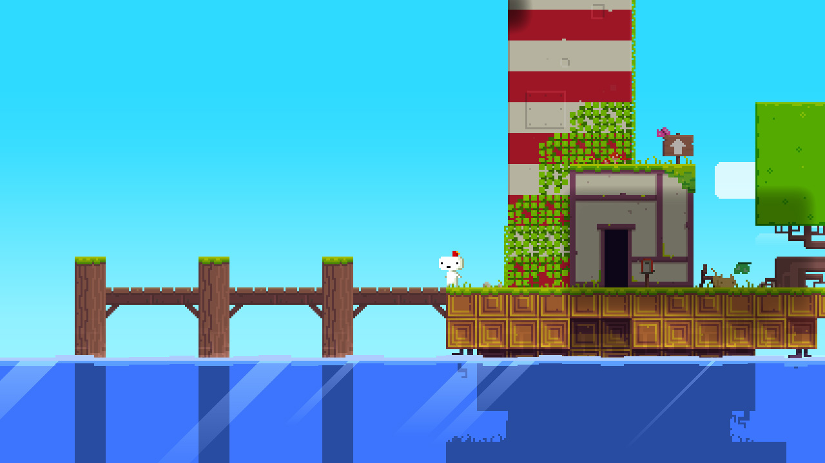
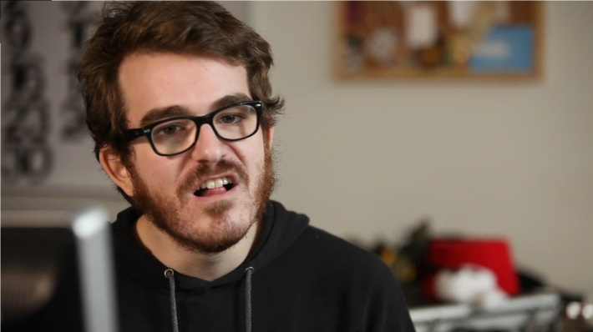
Indie games is a goal for many dev’s

Slide 26

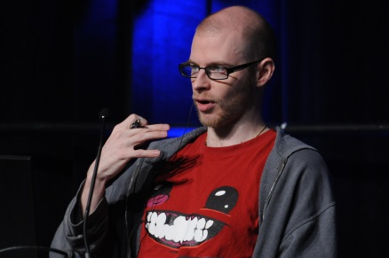
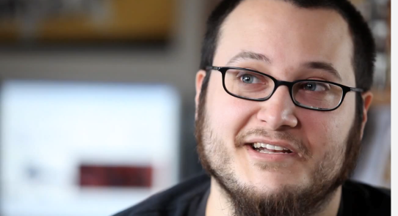
Indie games is a goal for many dev’s

Slide 27
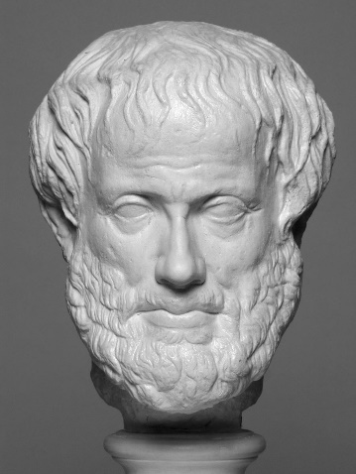
Games and Education
Greek “skole” (creative idleness) > school
We work hard in order to have “skole” (Aristotle)
The free time are best suited to exercise freedom of choice and the grow of virtues

Slide 28
What about you?
In the past I use Softimage
FATEC tested Panda3D and Pygame
But, for education purposes there are some drawbacks
Some installation problems
Difficult to give the game to friends
Solution: Codeskulptor for teaching programming

Slide 29
Interactive Programming with Python
Top Rated MOOC at CourseTalk
One game per week:
Rock, Spock, Paper, Lizard, Scissors
Guess the number
Stopwatch
Memory
Pong
Black Jack
Asteroids (other student, not me)

Slide 30
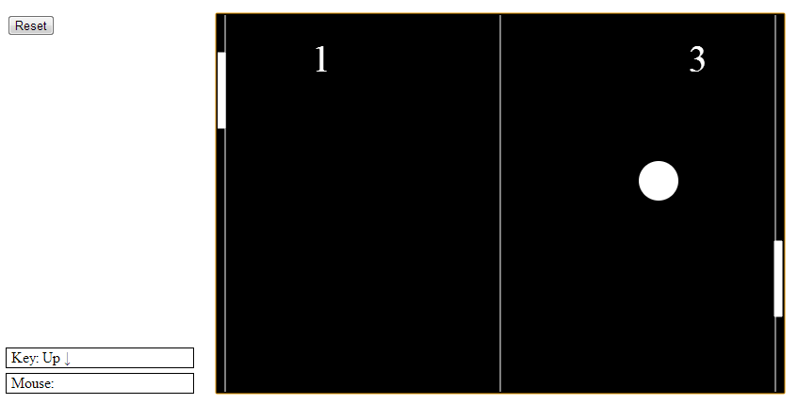
Pong

Slide 31
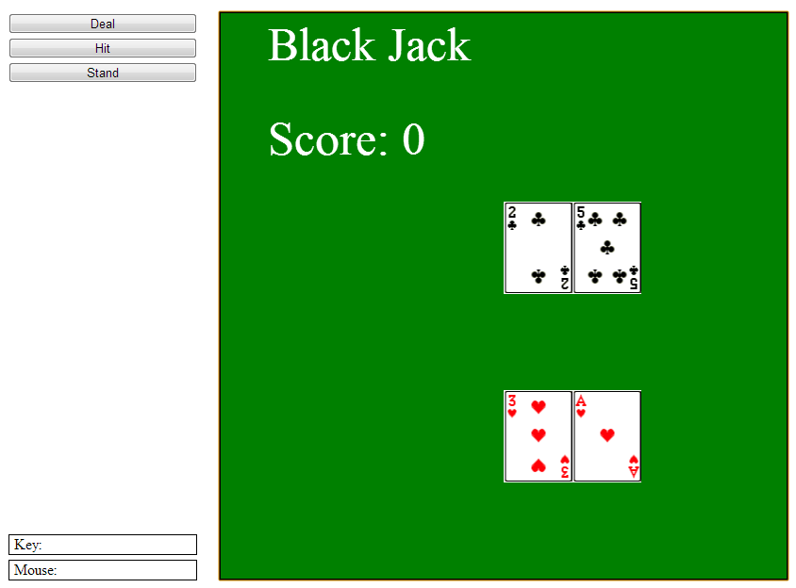
Black Jack

Slide 32
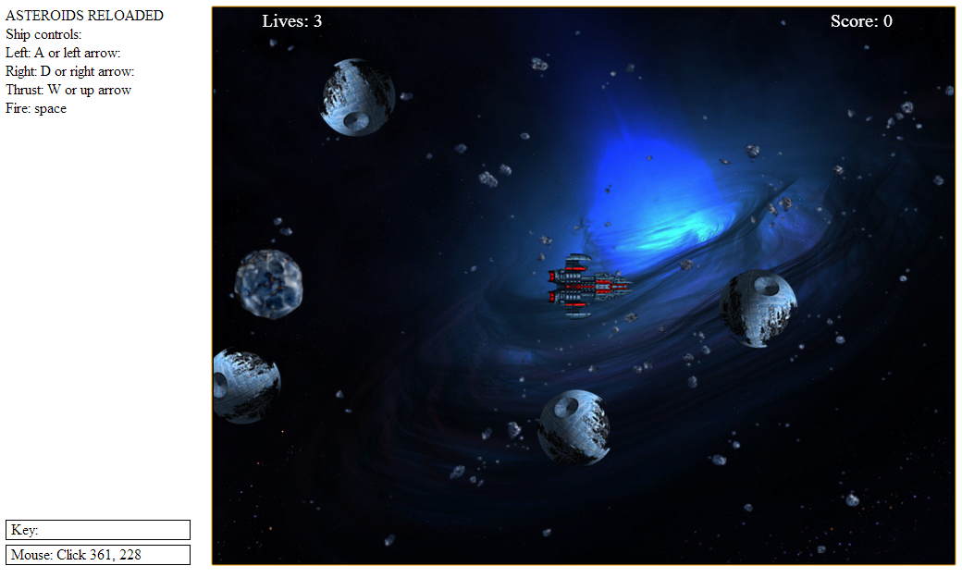
Rice Rocks (Asteroids)

Slide 33
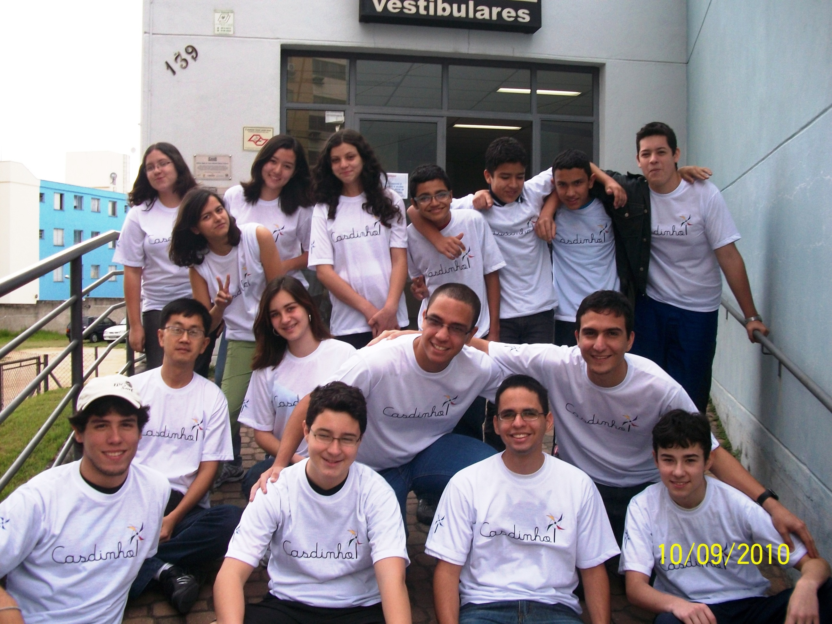
This kid finished the course with me!

Slide 34
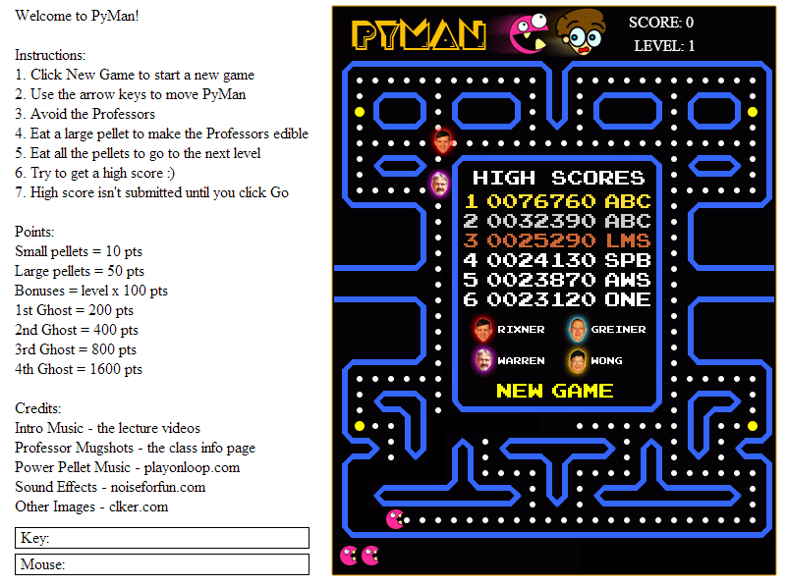
PyMan = Python Pacman

Slide 35
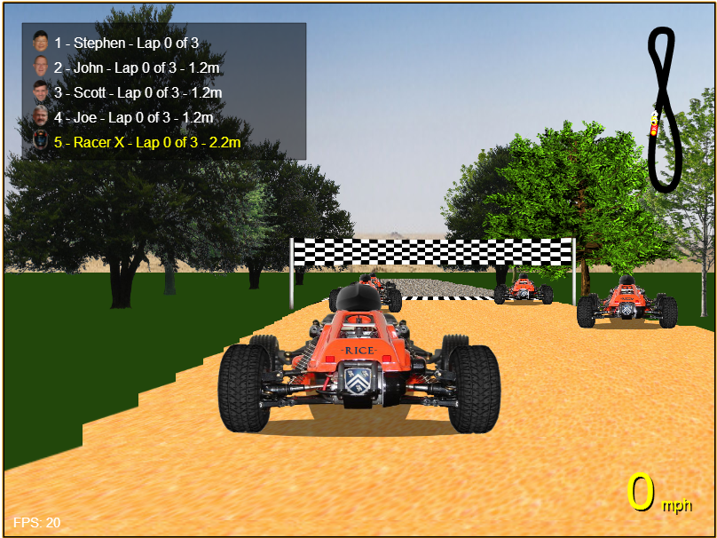
Rice Racer

Slide 36
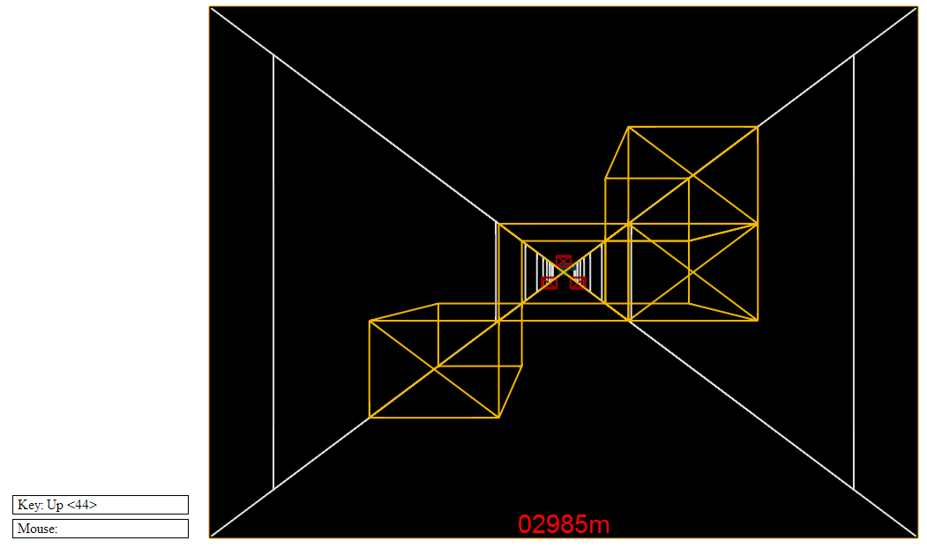
Star Wars

Slide 37
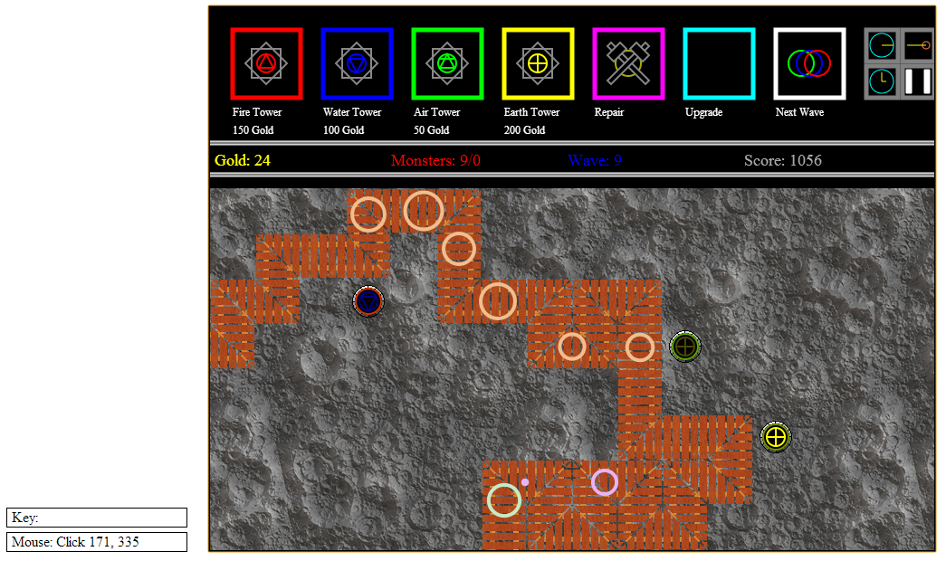
Tower Defence

Slide 38
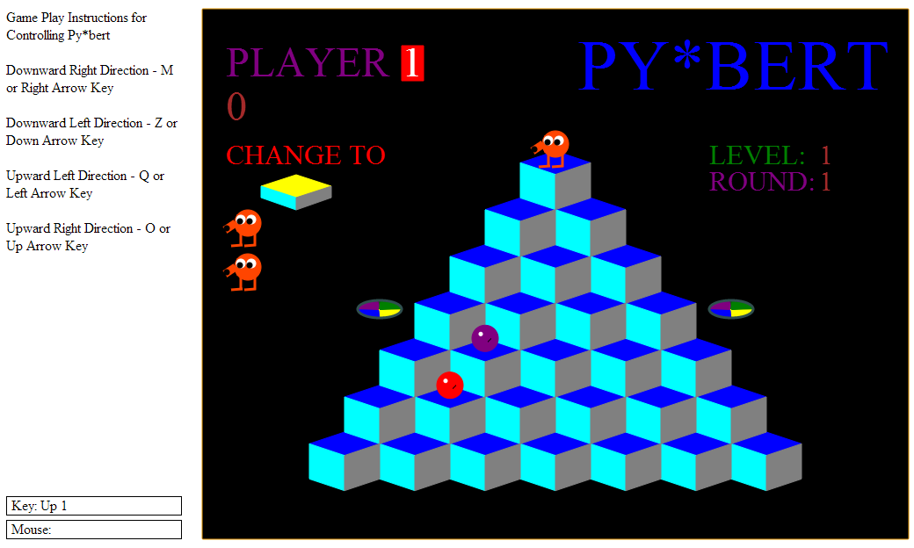
Py*bert = Python Q*bert

Slide 39
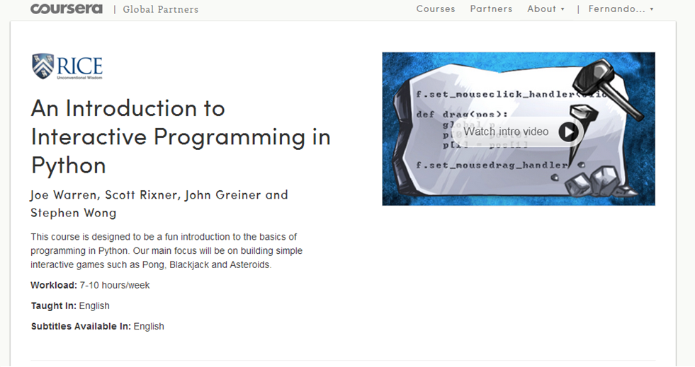
I recommend the course
https://www.coursera.org/course/interactivepython

Slide 40
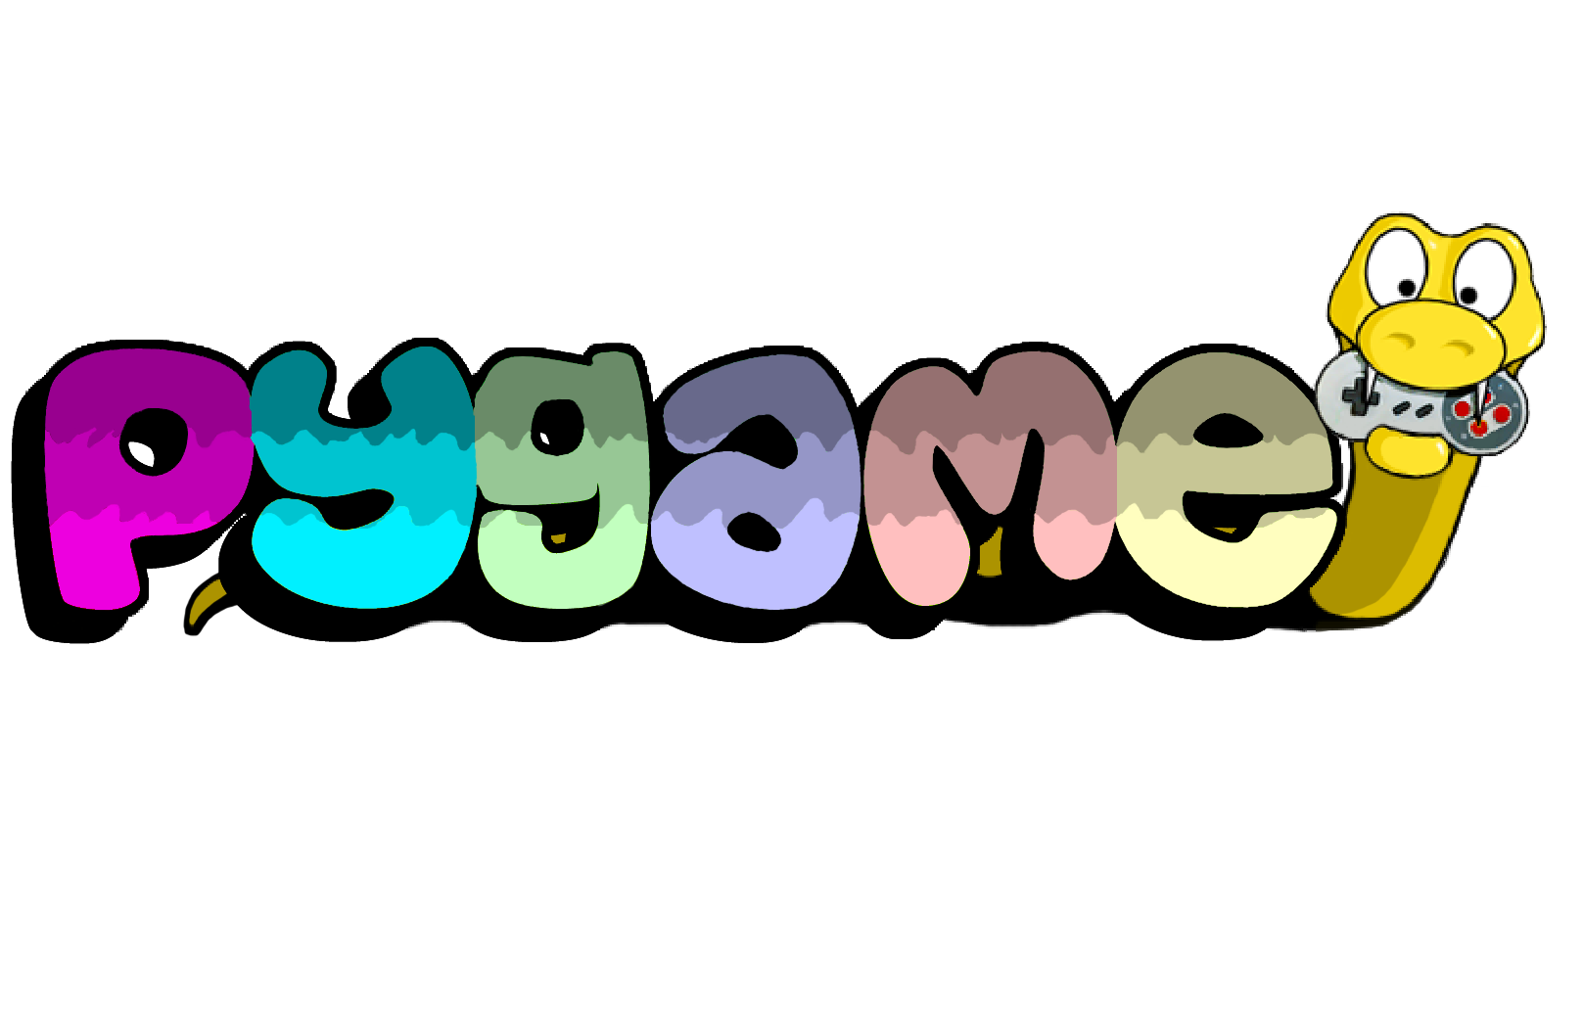
Desktop Demo

Slide 41
Fernando Masanori
linktr.ee/fmasanori
bit.ly/PPZPythonExercicios

